Slide 1

Revenue and Promotional Analysis Overview
Analysis Across Categories, Promotions, and Cities
Erick Yegon, 26th October 2024

Slide 2
Background
Analysis focused on retail promotional campaigns during two major Indian festivals: Diwali and Sankranti
Data covers multiple store locations across 10 major South Indian cities
Multiple product categories including Grocery & Staples, Home Care, Personal Care, Home Appliances, and Combo offerings
Various promotion types implemented: BOGOF, Cashback, and percentage-based discounts (25%, 33%, 50% OFF)

Slide 3
Problem Statement
The retail chain needed to:
Evaluate the effectiveness of promotional campaigns across different:
Store locations
Product categories
Promotion types
Identify patterns in:
Sales performance
Revenue generation
Customer response to different promotion types
Understand:
Geographic variations in promotion effectiveness
Category-wise performance during festivals
Price-sales relationships
Data Quality Issues:
Duplicate records in events data
Missing values in quantity sold metrics
Need for data cleaning and standardization
Performance Metrics:
Two critical KPIs established:
IR% (Incremental Revenue Percentage)
ISU% (Incremental Sold Units Percentage)
Market Coverage:
Varied store presence across cities:
Major metros (Bengaluru, Chennai, Hyderabad)
Tier-2 cities (Visakhapatnam, Coimbatore)
Smaller markets (Trivandrum, Vijayawada)

Slide 4
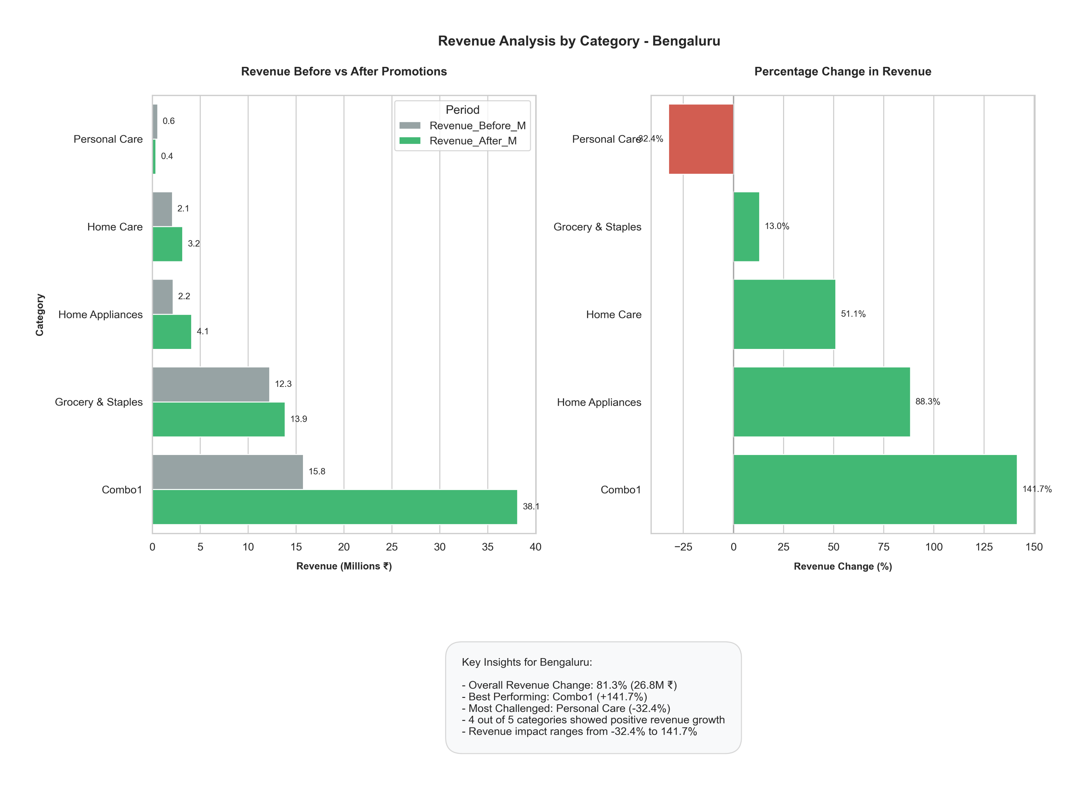
Revenue Before vs. After Promotions in Bengaluru
The revenue analysis for Bengaluru reveals significant variations in promotional effectiveness across different product categories.
Combo1 emerges as the standout performer with an exceptional 141.7% revenue increase, jumping from ₹15.8M to ₹38.1M, demonstrating the strong appeal of bundled offerings in this market.
Home Appliances and Home Care categories also showed robust growth with 88.3% and 51.1% revenue increases respectively.
Grocery & Staples, despite having the second-highest absolute revenue (₹19.9M after promotions), showed a modest 13.5% growth, suggesting limited price sensitivity in essential categories.
Notably, Personal Care was the only category showing negative performance with a -32.4% revenue decline, indicating potential issues with promotion strategy or market fit in this segment.
Overall, 4 out of 5 categories demonstrated positive revenue growth, with percentage changes ranging from -32.4% to 141.7%, indicating that while promotions were generally effective, their impact varied substantially by category.

Slide 5
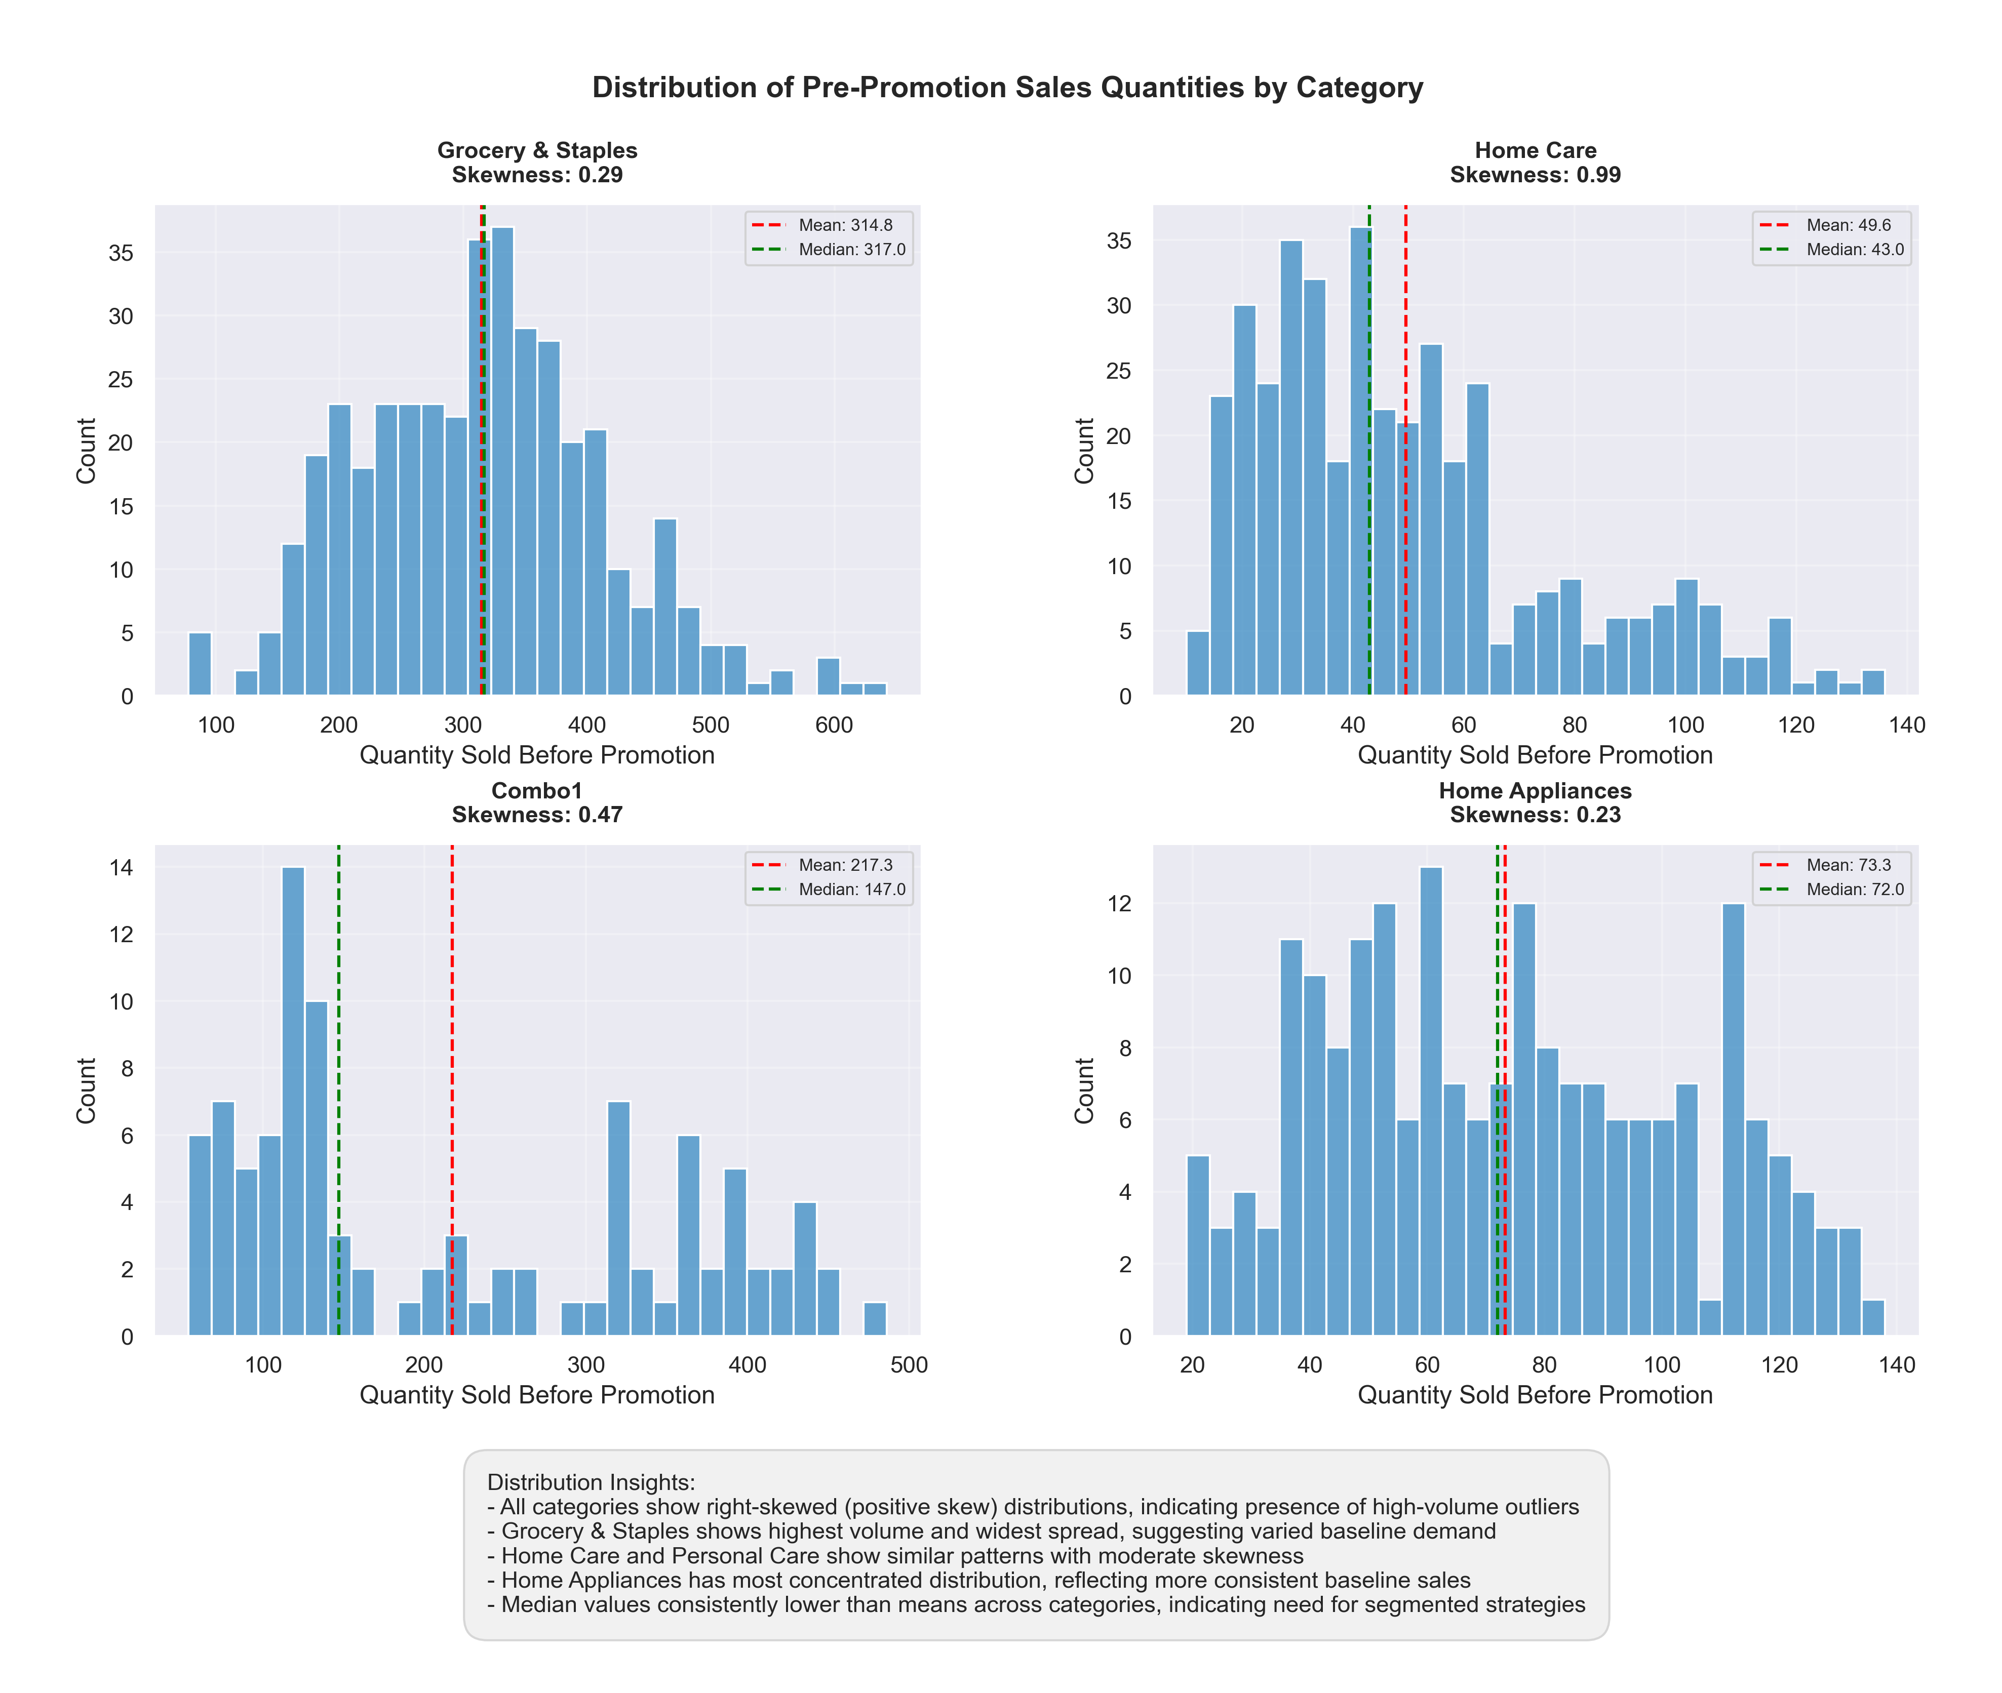
Pre-Promotion Sales by Category
Grocery & Staples shows the highest sales volume with a mean of 314.8 units and relatively normal distribution (skewness 0.29), indicating stable baseline demand.
Home Care and Combo1 categories display moderate positive skew (0.99 and 0.47 respectively), suggesting some high-volume outlier stores or products.
Notably, Home Appliances shows the most concentrated distribution (skewness 0.23) with lower volumes (mean 73.3 units), reflecting more consistent but lower baseline sales.
Across all categories, the median values are consistently lower than means, pointing to a right-skewed nature of sales and suggesting the need for segmented promotion strategies that account for these varying baseline demand patterns.
This variation in distribution patterns across categories indicates that a one-size-fits-all promotional approach may not be optimal, and category-specific strategies should be considered based on their unique sales distribution characteristics.

Slide 6
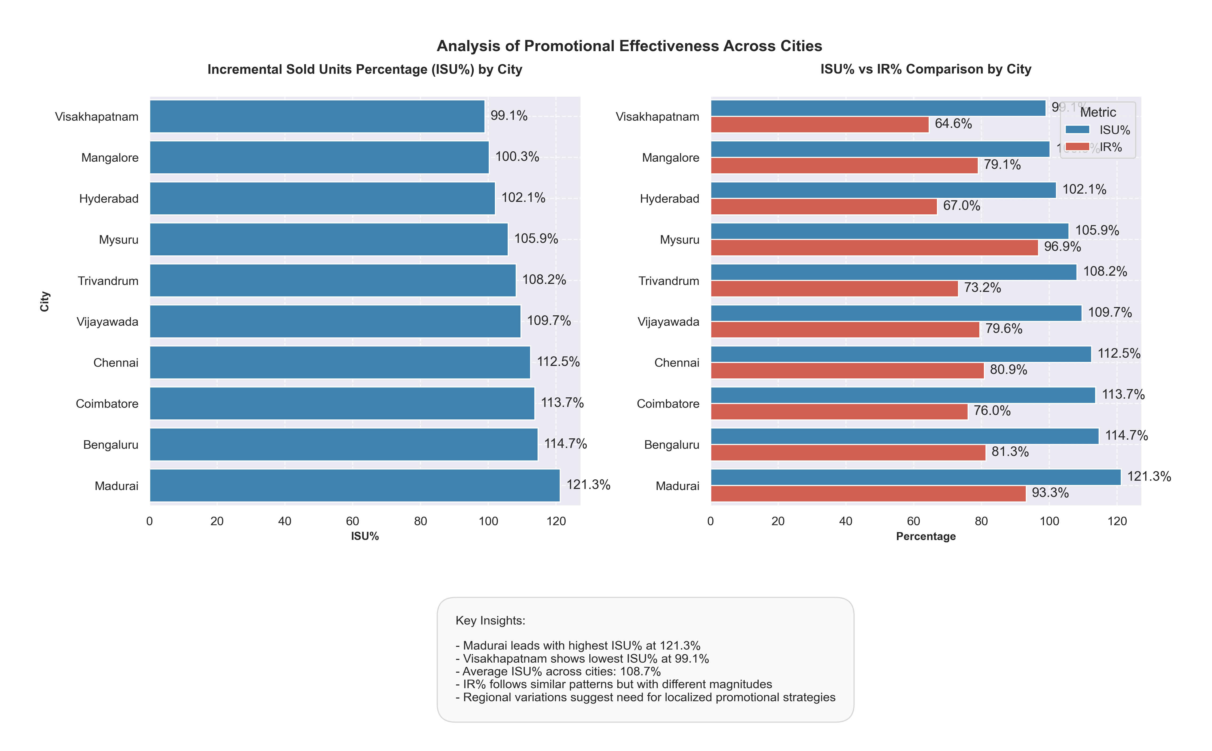
Promotional Effectiveness Comparison by City
The analysis of promotional effectiveness across cities reveals significant regional variations in both Incremental Sold Units (ISU%) and Incremental Revenue (IR%) metrics.
Madurai demonstrates exceptional performance with the highest ISU% at 121.3% and a strong IR% of 93.3%, indicating particularly effective promotional strategies in this market.
Conversely, Visakhapatnam shows the lowest ISU% at 99.1% with a notably lower IR% of 64.6%, suggesting room for optimization in this region.
There's a consistent pattern where ISU% generally outperforms IR% across all cities, with an average ISU% of 108.7%, pointing to successful volume growth but potentially compressed margins due to promotional discounts.
The gap between ISU% and IR% varies significantly by city (for example, Mysuru shows the smallest gap with ISU% at 105.9% and IR% at 96.9%), indicating varying levels of promotional efficiency and suggesting the need for customized, location-specific promotional strategies to optimize both volume and revenue growth.

Slide 7
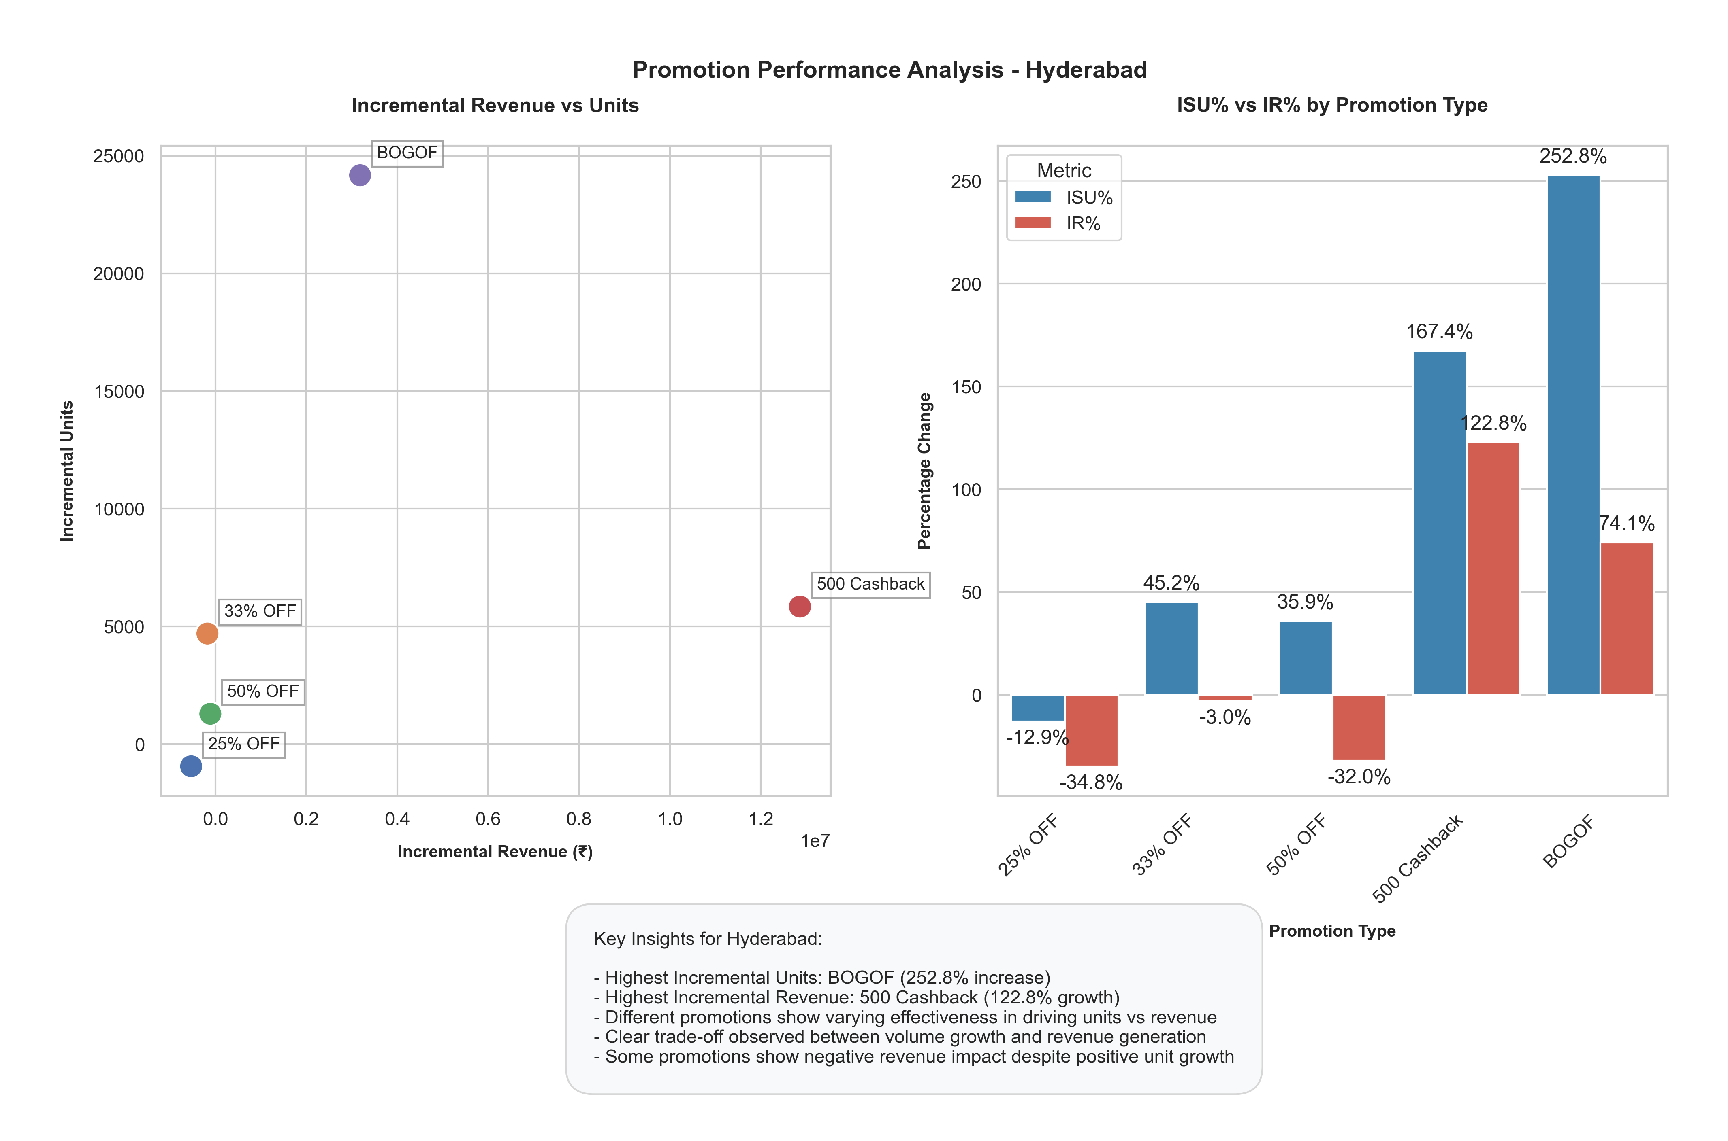
Promotion Types Impact in Hyderabad
The promotion performance analysis for Hyderabad reveals striking variations in effectiveness across different promotion types.
BOGOF (Buy One Get One Free) emerges as the most aggressive volume driver, achieving an exceptional 262.8% increase in ISU%, but with a more modest 74.1% growth in IR%, indicating a significant trade-off between volume and revenue.
The 500 Cashback promotion demonstrates the strongest revenue performance with 122.8% IR% growth while maintaining a healthy 167.4% increase in unit sales. Notably, percentage-based discounts (25%, 33%, and 50% OFF) show concerning trends, with all three generating negative IR% despite positive ISU% for 33% and 50% OFF promotions.
This suggests these discount structures may be too deep, eroding profitability despite driving some volume.
The clear inverse relationship between promotion depth and revenue effectiveness highlights the need for careful promotion design that balances volume growth with revenue sustainability, particularly in the Hyderabad market.

Slide 8
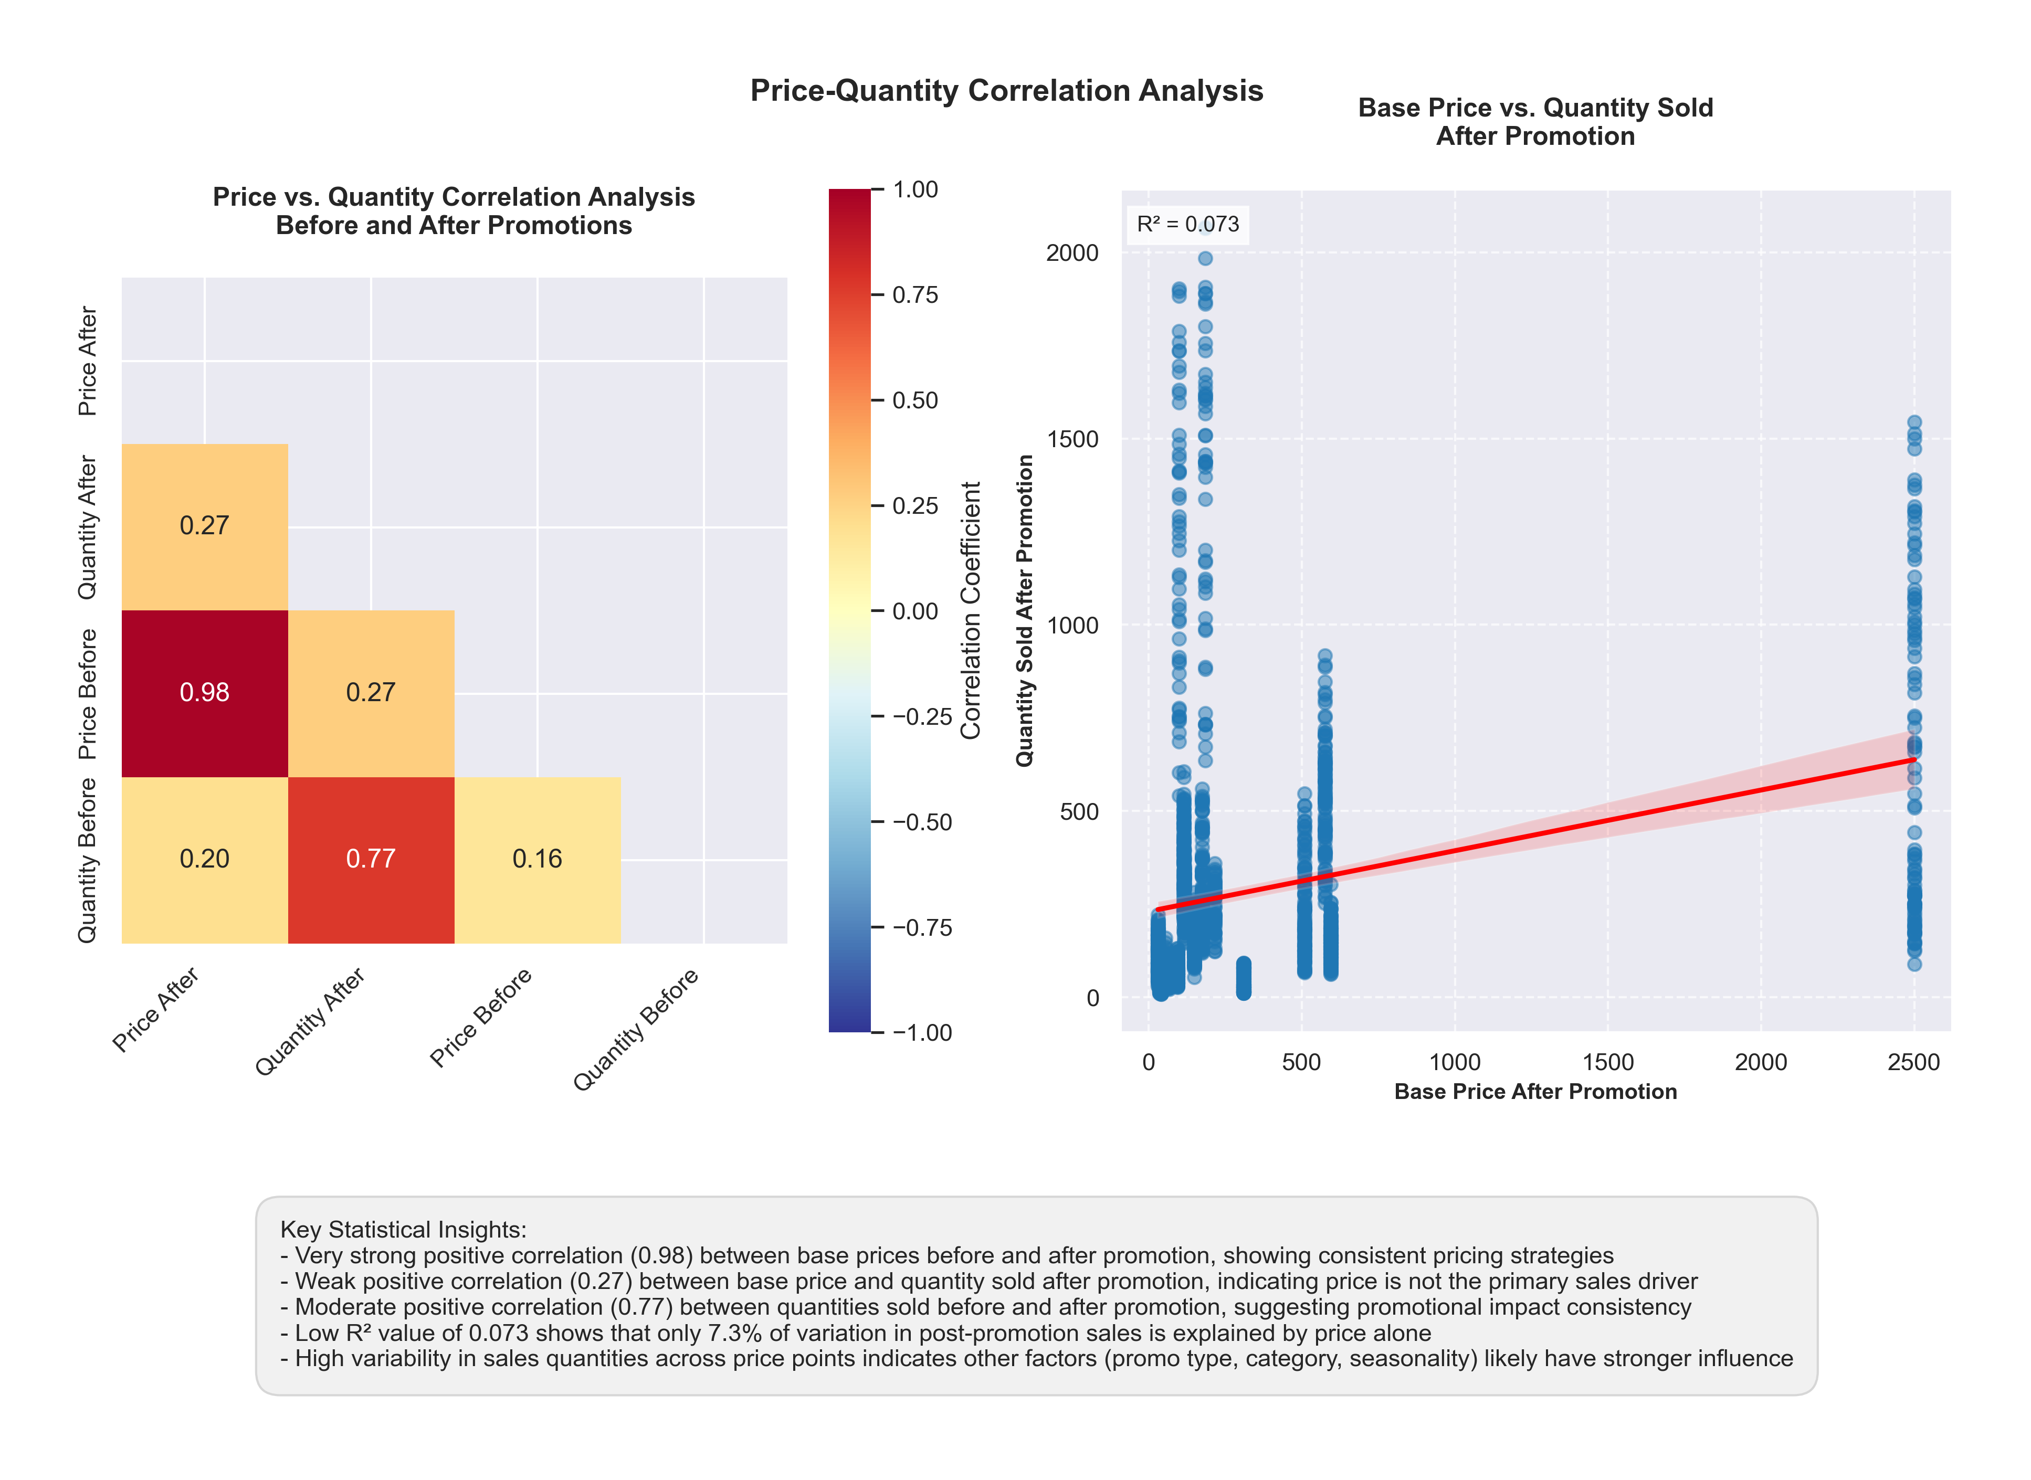
Price-Quantity Correlation
The price-quantity correlation analysis reveals several key insights about pricing dynamics and promotional effectiveness.
The correlation matrix shows a very strong positive correlation (0.98) between base prices before and after promotions, indicating consistent pricing strategies and minimal price architecture disruption.
However, the weak positive correlation (0.27) between base price and quantity sold after promotion suggests that price is not the dominant driver of sales performance.
The scatter plot, with its low R² value of 0.073, further confirms this weak price-quantity relationship, showing significant scatter and variability in sales response across different price points.
The moderate positive correlation (0.77) between quantities sold before and after promotions indicates that pre-existing demand patterns largely persist through promotional periods.
Interestingly, the vertical clusters in the scatter plot at specific price points suggest that other factors beyond pricing (such as promotion type, category, or seasonality) likely have stronger influences on sales performance, highlighting the need for a more holistic approach to promotional strategy beyond pure price mechanics.

Slide 9
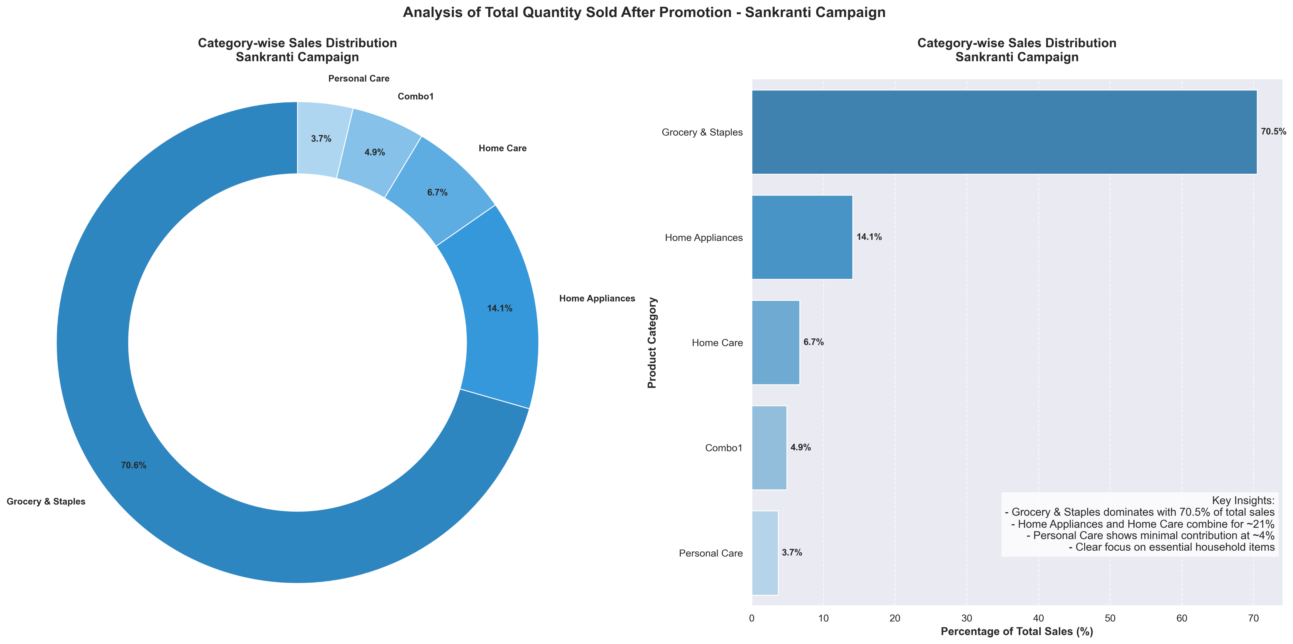
Category-Wise Sales Distribution – Sankranti Campaign
The analysis of total quantity sold during the Sankranti Campaign reveals a highly skewed distribution across product categories, with Grocery & Staples overwhelmingly dominating the sales mix at 70.5% of total sales.
Home Appliances emerges as the second-largest category with 14.1% of sales, while Home Care contributes 6.7%. The combined share of Home Appliances and Home Care accounts for approximately 21% of total sales, indicating a significant focus on household essentials and durables during the festival period.
Combo1 and Personal Care categories show relatively minimal contributions at 4.9% and 3.7% respectively, suggesting lower promotional effectiveness or consumer interest in these categories during Sankranti.
This distinct sales pattern, heavily weighted towards essential household items (Grocery & Staples), indicates that the Sankranti campaign resonated most strongly with basic household needs rather than discretionary purchases, potentially reflecting festival-specific shopping behaviors and promotional effectiveness.

Slide 10
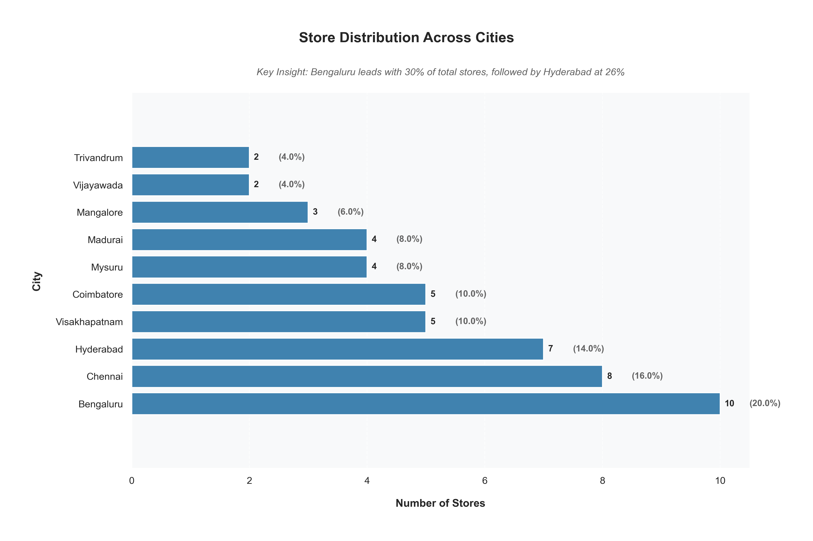
Store Distribution by City
The store distribution analysis across cities reveals a concentrated retail presence in major South Indian metropolitan areas. Bengaluru leads with the highest store count of 10 stores (20% of total), followed by Chennai with 8 stores (16%) and Hyderabad with 7 stores (14%), collectively accounting for 50% of the total retail network.
There's a clear tier structure in the distribution: the top tier (Bengaluru, Chennai, Hyderabad) with 7-10 stores each, a middle tier comprising Visakhapatnam and Coimbatore with 5 stores each (10% each), and a lower tier including Mysuru and Madurai with 4 stores each (8%).
The smallest presence is in Trivandrum and Vijayawada with just 2 stor
es each (4%), suggesting potential growth opportunities. This distribution pattern indicates a strategic focus on major urban centers, with store density correlating strongly with market size and economic potential.

Slide 11
Conclusions- Key Business Insights:
Promotional Effectiveness:
Cashback (122.8% revenue growth) and BOGOF (262.8% unit growth) emerge as top performers
Percentage-based discounts (25%, 33%, 50% OFF) show negative revenue impact despite volume gains
Clear trade-off between volume growth and revenue generation across promotion types
Category Performance:
Grocery & Staples dominance (70.5% of total sales) during Sankranti campaign
Home Appliances (14.1%) and Home Care (6.7%) form second tier of sales
Personal Care shows lowest contribution at 3.7%, indicating optimization opportunity
Geographical Impact:
Madurai leads with highest ISU% (121.3%) and strong IR% (93.3%)
Visakhapatnam shows lowest ISU% (99.1%) with 64.6% IR%
Store concentration in major metros (Bengaluru 20%, Chennai 16%, Hyderabad 14%)
Price-Sales Dynamics:
Strong base price consistency (0.98 correlation) before and after promotions
Weak price-quantity relationship (0.27 correlation) suggests non-price factors drive sales
Pre-existing demand patterns persist through promotional periods (0.77 correlation)

Slide 12
Recommendations
Promotion Strategy:
Phase out underperforming percentage discounts
Expand successful Cashback and BOGOF programs
Customize promotion mix by category and city
Category Management:
Strengthen Grocery & Staples promotional support during festivals
Develop targeted strategies for underperforming categories
Optimize category mix based on local market dynamics
Geographic Expansion:
Leverage learnings from high-performing cities
Address performance gaps in lower-performing markets
Align store expansion with market potential
Price Optimization:
Maintain consistent price architecture
Focus on non-price drivers of sales
Develop category-specific pricing strategies

